Slide 1
Working with Python for Data Science

Slide 2

HELLO!
I am Arpit Jain
I am here because Data Science is my passion and I love sharing my expertise with people.

Slide 3
Agenda
1
Introduction to Data Analytics
Python Refresher
Variables, Operators
Data Structures – Python
Functions
Intro to NumPy and SciPy
Data Manipulation with Pandas

Slide 4
In the end you should only measure and look at the numbers that drive action, meaning that the data tells you what you should do next.

Slide 5
What is Data Science
Data science is the domain of study that deals with vast volumes of data.
Using modern tools and techniques, helps find unseen patterns, derive meaningful information, and make business decisions.
The data used for analysis can come from many different sources and presented in various formats.

Slide 6
The Data Science Lifecycle
Capture
Maintain
Process
Analyze
Communication

Slide 7
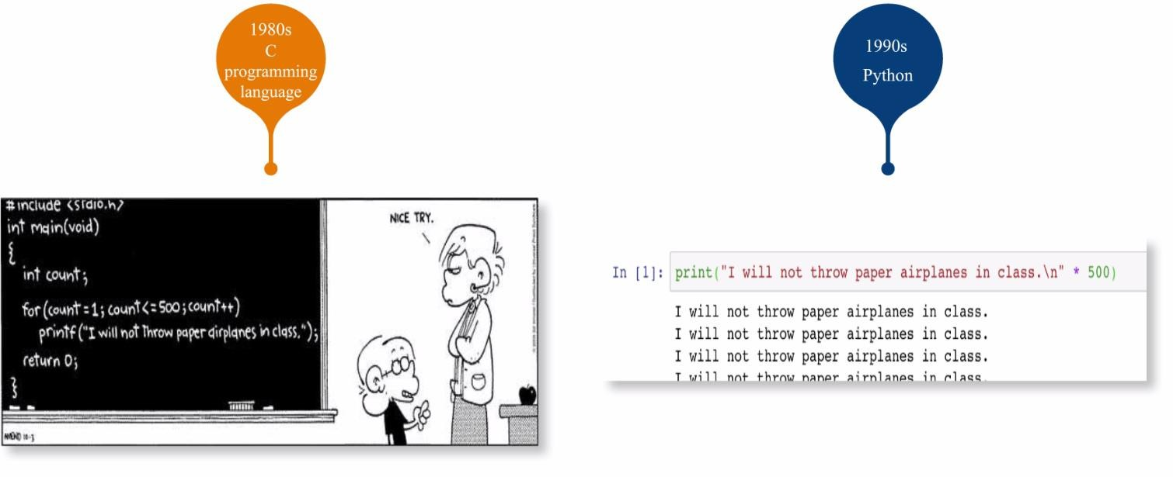
Python

Slide 8
Python – Major Benefits

Slide 9
Python – Refresher
Variables
Data Types
Operators
Functions
Modules

Slide 10
Python – NumPy & SciPy
On Notebook

Slide 11
Python – Pandas
On Notebook

Slide 12

Thank You

